Slide 1
OOPS with java presentation on topic
“records” and “sealed classes”
presented By-
Kartik verma
Kamakshi verma
Kanhiya sharma
Karan gupta
SUBMITTED TO-
MR JITENDRA SINGH

Slide 2
Introduction to Java Records
What is a Record? :-
Introduced in Java 14 as a preview feature, officially released in Java 16.
A special kind of class designed to hold immutable data.
Automatically generates the boiler plate code such as constructors , getters , equals(), hashCode() and toString() method.

Slide 3


Syntax and example code
Basic syntax:-
Example- Suppose we make a record named person with 2 parameters:-
The automatically generated methods for the given record will be:-
public String name() public boolean equals(Object o) public String toString()
public int age() public int hashCode()

Slide 4
Benefits and limitations of using records
benefits
limitations
Immutability
  Fields are final and cannot be changed after creation.
Boilerplate Reduction
  No need to manually write common methods.
Improved Readability
  Clear and concise representation of data.
No Inheritance
  Records cannot extend other classes (but can implement interfaces).
Immutability Constraints
  All fields are final and cannot be reassigned.
Suitability:
  Best for simple data-carrying classes, not for complex business logic.

Slide 5
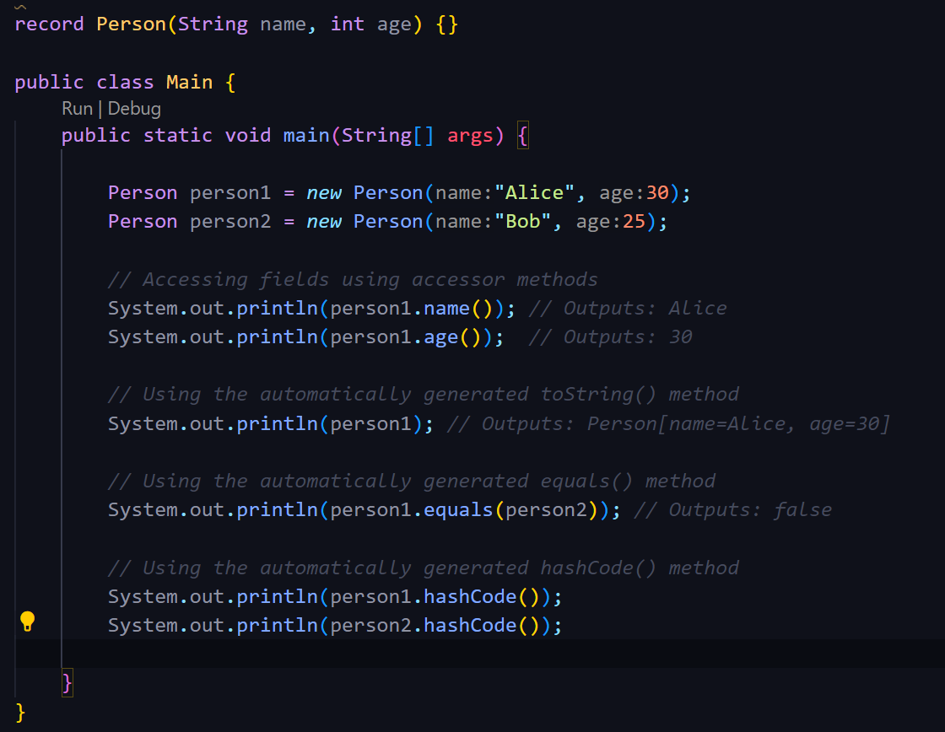
Lets see the working of a record
As we can see after declaring the
Record “Person”, how different methods
Gets automatically generated by the
Compiler and there usage.

Slide 6
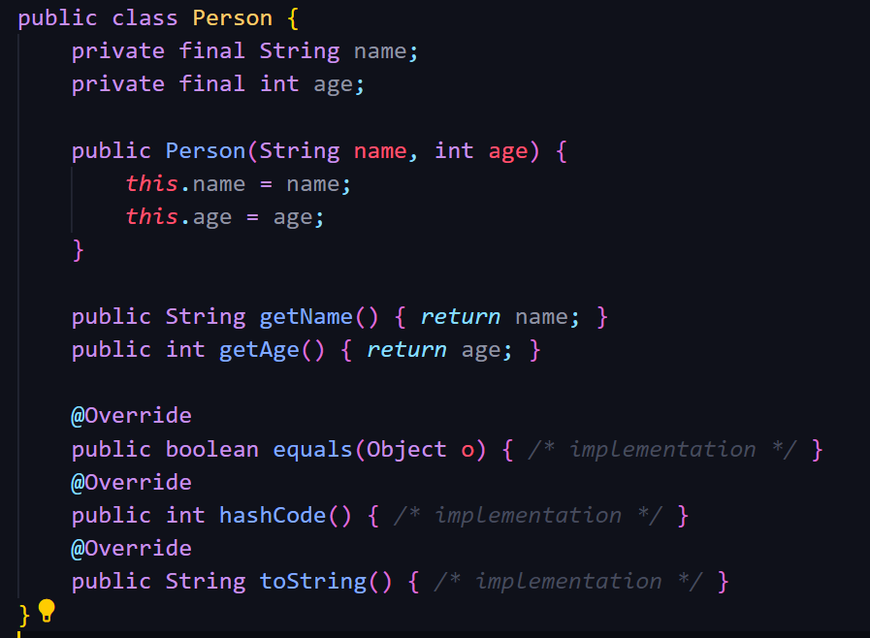

Record vs no record??
What’s the difference?
Literally one liner
Your hard work right here….

Slide 7
Some practical use cases of records:-
DTOs (Data Transfer Objects)
  Simplifies the creation of objects used to transfer data between layers.
Value Objects
  Ideal for objects that represent a fixed set of data, such as coordinates, points, etc.
Configuration Objects
  Can be used to store configuration settings that do not change.

Slide 8
INTRODUCTION TO SEALED CLASSES IN JAVA
What is a sealed class?
A new feature introduced in Java 15
Sealed classes are a new feature in Java that restricts which other classes or interfaces may extend or implement them.
Helps in creating more robust and maintainable class hierarchies.

Slide 9
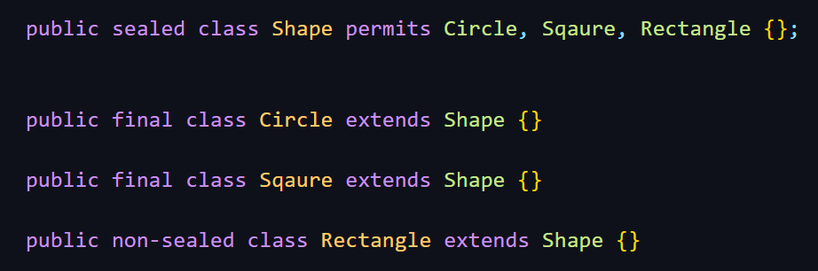
BASIC SYNTAX AND EXAMPLE CODE FOR SEALED CLASSES
Basic syntax :-
1. Use the sealed modifier.
2. Followed by the permits keyword to specify permitted subclasses.
Example of a sealed class :-
1. Shape is the sealed class.
2. Circle and Square are final classes.
3. Rectangle is non-sealed, meaning it can be further extended.

Slide 10
benefits and Limitations of sealed classes
Aspect | Benefits | Limitations
Control Over Class Hierarchies | Provides better control over which classes can extend or implement them. | Restricts extensibility; only specified classes can extend the sealed class.
Security | Enhances security by preventing unauthorized or unintended extensions. | -
Complexity in Large Projects | - | Managing sealed classes in large projects may introduce complexity.
Compatibility | - | Might cause issues with existing libraries/frameworks that rely on open class hierarchies.
Performance | JVM optimizations can be made due to known class hierarchy, potentially improving runtime performance. | -

Slide 11
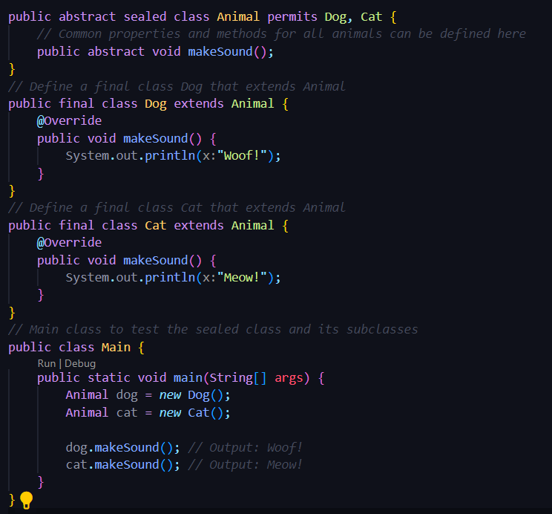
LET’S SEE THE WORKING OF SEALED CLASSES!!!
The Animal class is defined as a sealed class using the
sealed keyword.
Dog and cat are the final classes that extends Animal.
It provides an implementation for the makeSound() method.
In the main class we create dog() and cat() instances.
It demonstrates polymorphism.

Slide 12
Let’s see what difference does sealed classes make in the code
`KEY POINTS | WITH SEALED CLASSES | WITHOUT SEALED CLASSES
Controlled Extension: | Only the specified classes (Dog and Cat) can extend Animal. This control prevents unauthorized or unexpected extensions. | Any class can extend Animal, potentially leading to an unintended or overly complex class hierarchy.
Improved Security: | you restrict which classes can extend it, enhancing security by preventing unauthorized extensions. | There is no restriction on which classes can extend the base class, which might expose the class hierarchy to misuse.
Enhanced Maintainability: | The explicit control over the hierarchy makes the codebase easier to understand and maintain, as the permitted subclasses are clearly defined. | The class hierarchy can become difficult to maintain as any class can extend the base class.
Readability and Explicitness: | The hierarchy is explicit, improving code readability | The hierarchy can be implicit and unclear, especially in large codebases.

Slide 13
SOME PRACTICAL USES OF SEALED CLASSES
Sealed classes are useful in domain-driven design (DDD) to model a fixed set of domain concepts that should not be extended arbitrarily.
State Machines
  Sealed classes can represent states in a state machine, ensuring that only defined states are used.
API Design
  When designing public APIs, controlling the extension of classes is crucial to maintain backward compatibility and ensure that only intended classes can be used by clients.
Role-Based Access Control
  Sealed classes can enforce strict role hierarchies in access control systems, ensuring that only specific roles are defined and used.

Slide 14
THANKYOU!!

